Slide 1

磁共振影像系統
作業二
https://github.com/chenyuyuy/MRI-HW2
老師：黃騰毅
學生：M11302208陳宥余

Slide 2
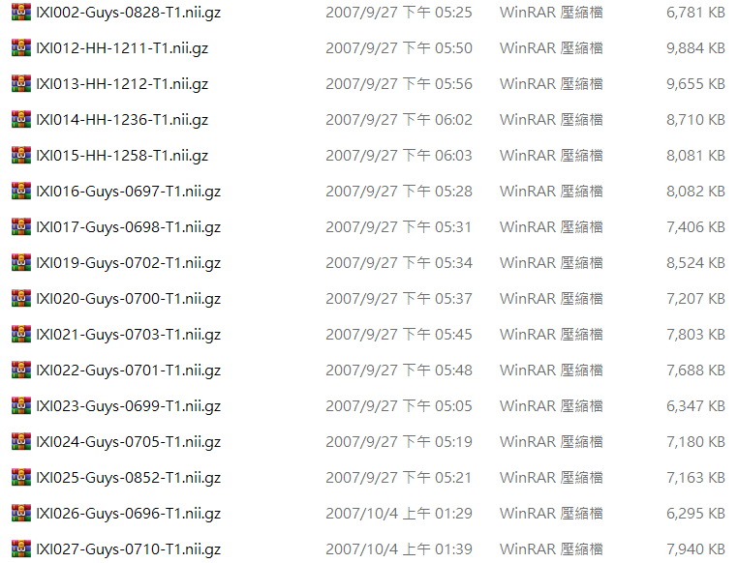
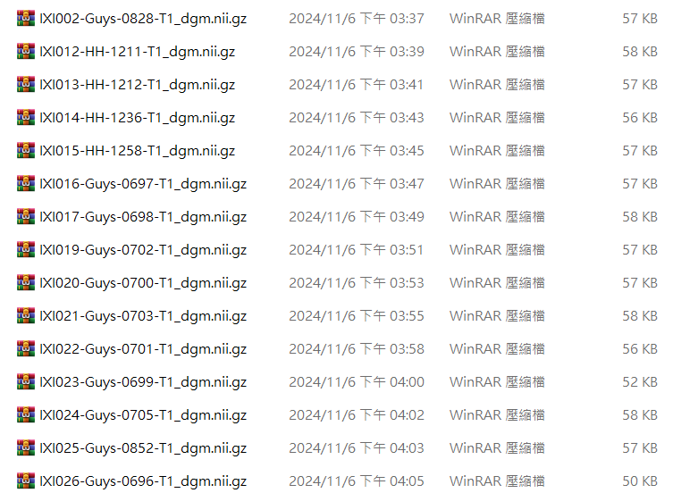
(1) Please use the TigerBx software to perform brain segmentation.

Slide 3
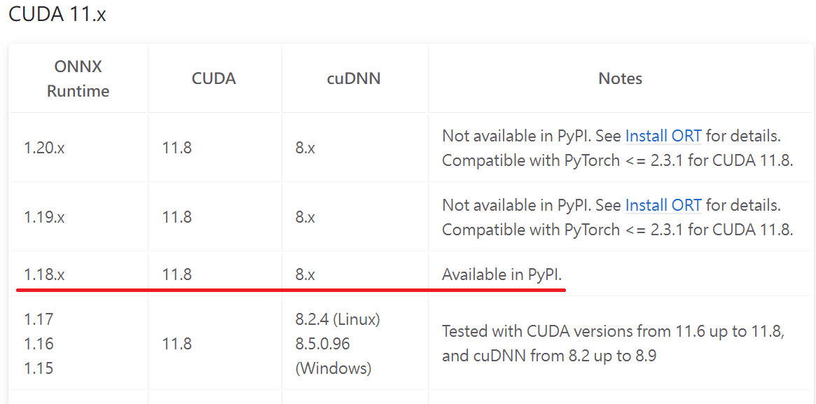
(1) Please use the TigerBx software to perform brain segmentation.
onnxruntime-gpu v1.18.0+cuda11.8+cuDNN v8.9.7 withGTX1060

Slide 4
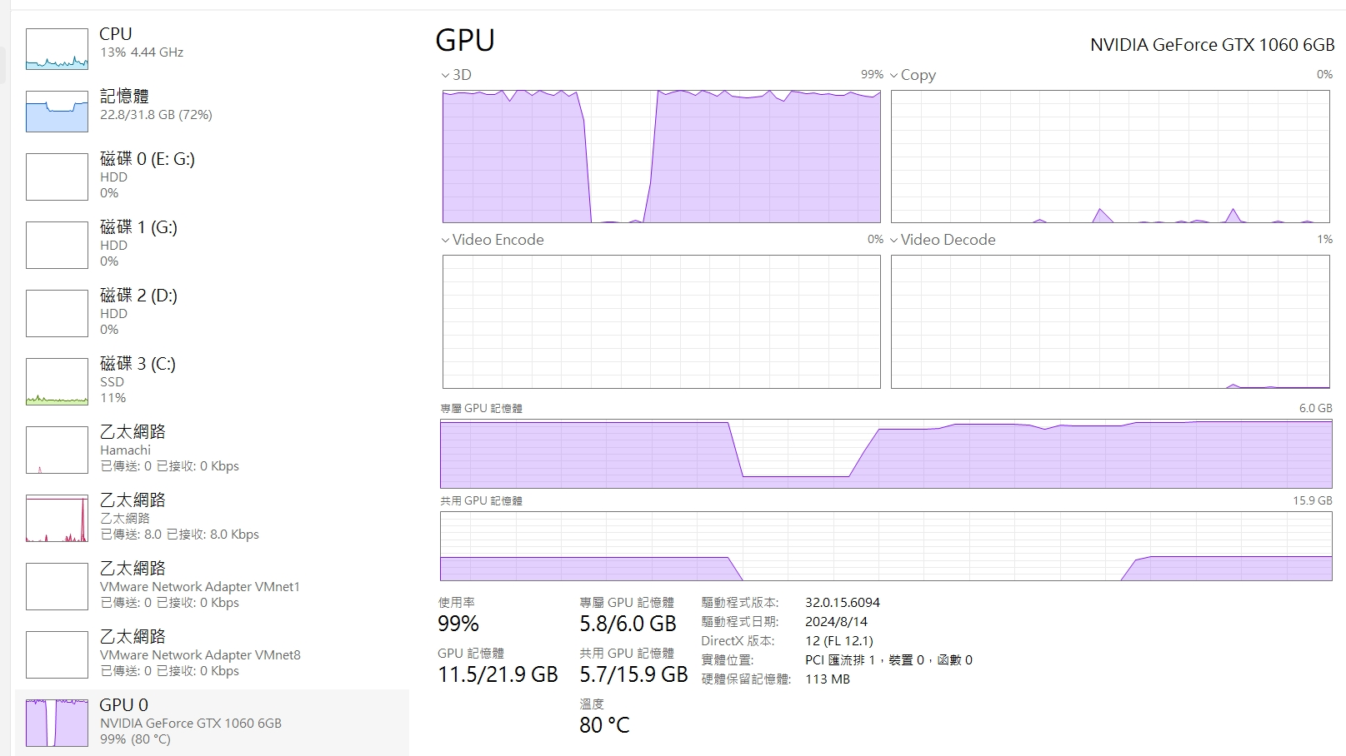
(1) Please use the TigerBx software to perform brain segmentation.
onnxruntime-gpu v1.18.0+cuda11.8+cuDNN v8.9.7 withGTX1060

Slide 5
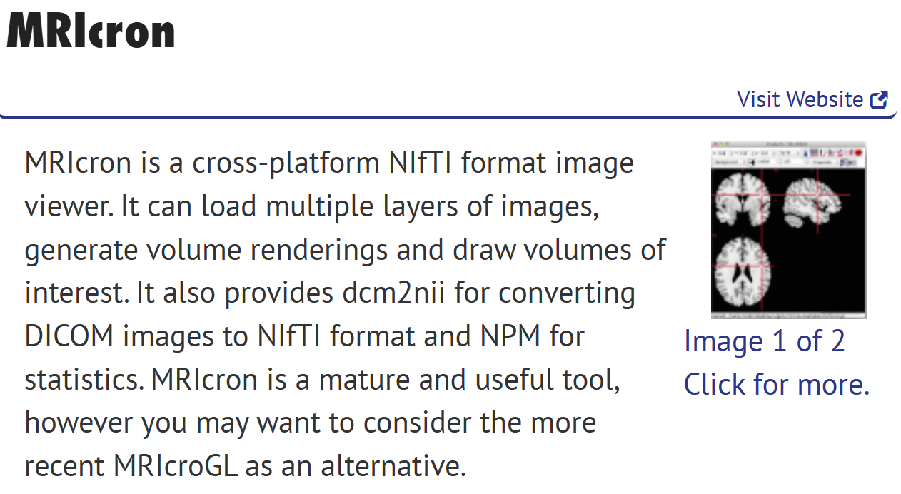
(1) Please use the TigerBx software to perform brain segmentation.

Slide 6
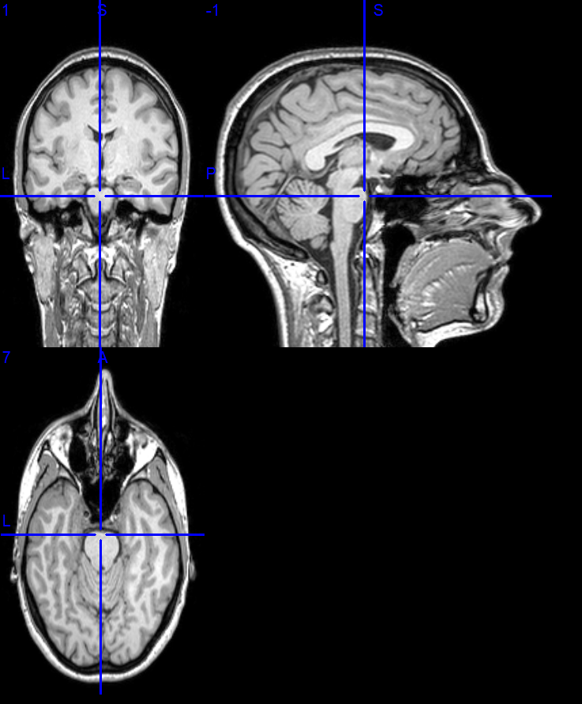
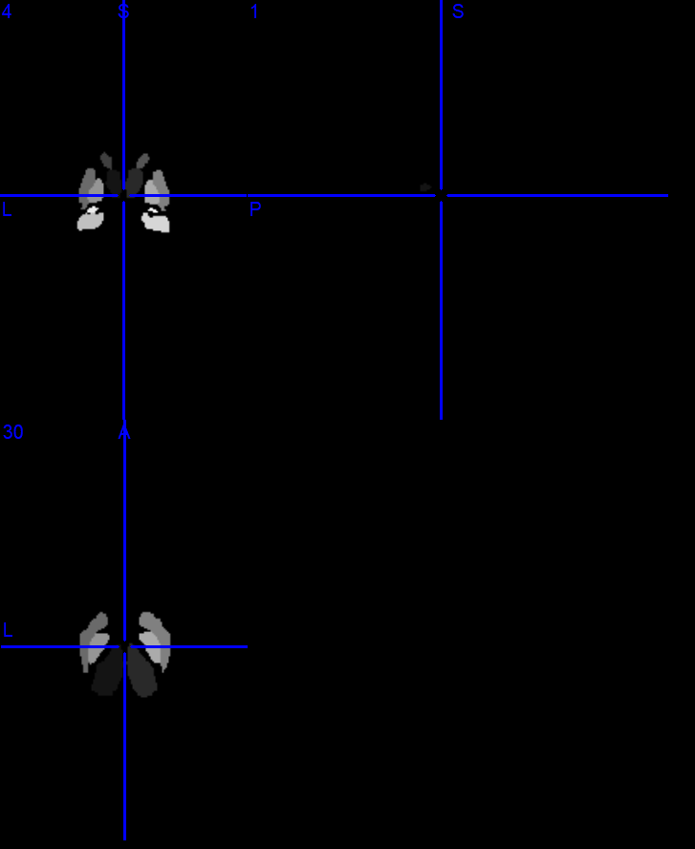
(1) Please use the TigerBx software to perform brain segmentation.

Slide 7
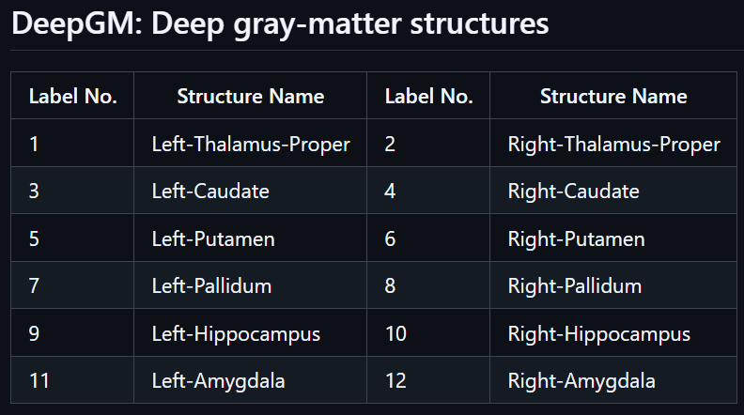
(1) Please use the TigerBx software to perform brain segmentation.

Slide 8
(2) Calculate the volumes of the subcortical regions of the brain for these subjects.
1. Define
brain region labels
2. Set
file folder path
3. Create
results table
4. Read
each NIfTI file
5. Calculate
Voxel count
6. Calculate
Voxel volume
7. Calculate
Voxel count * volume for each region
8. Export as Excel file

Slide 9
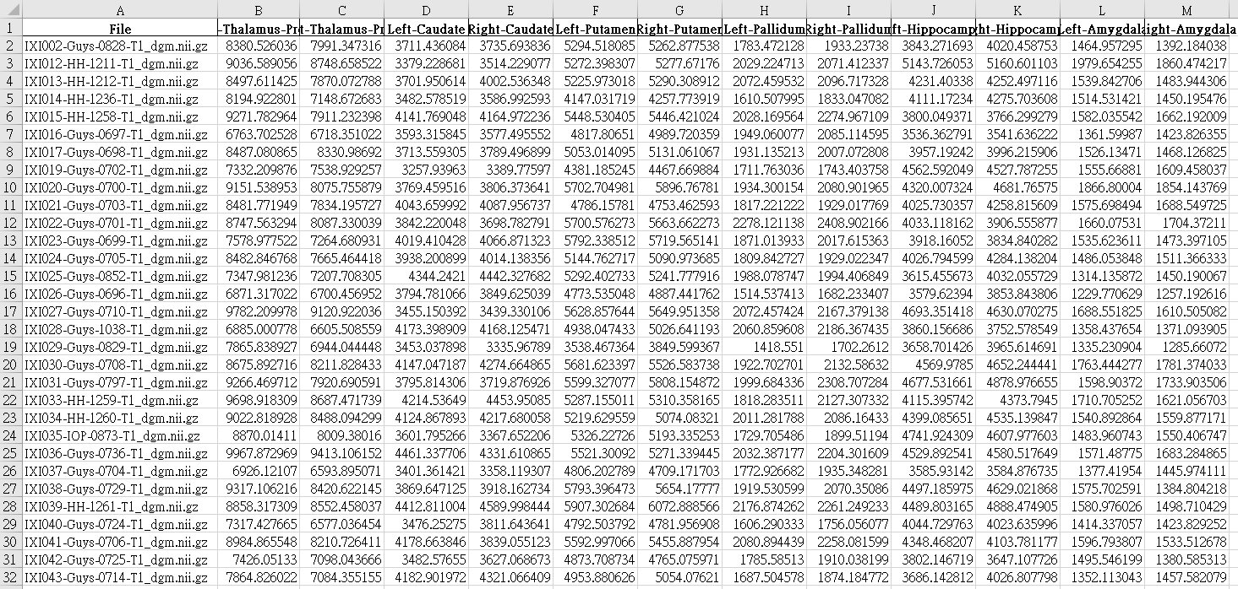
(2) Calculate the volumes of the subcortical regions of the brain for these subjects.

Slide 10
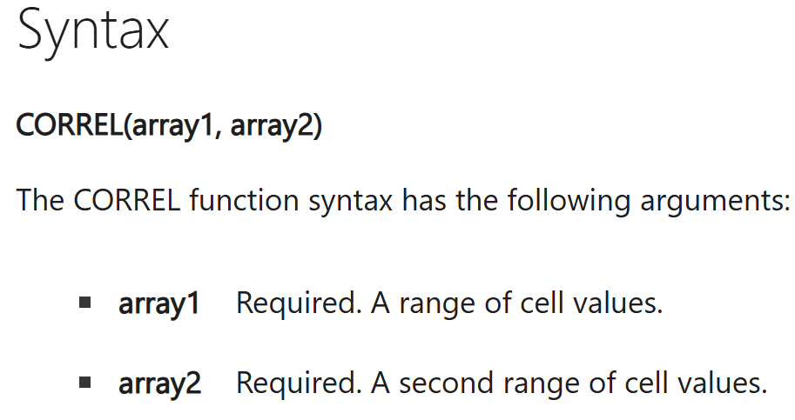
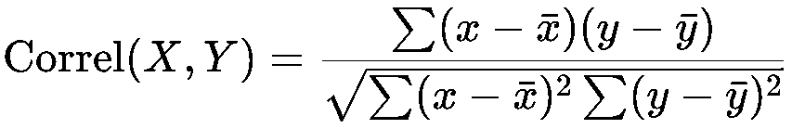
(3) Based on the demographic information provided by the original website, try to explore the correlation between the volumes of various subcortical regions and the subjects' information. For example, is there a correlation between the hippocampus or thalamus and the age of the subjects?
Pearson Correlation Coefficient

Slide 11
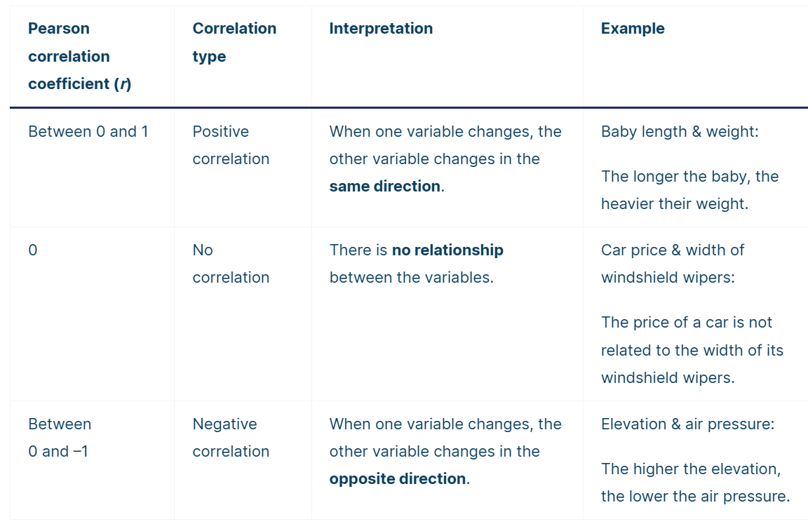
(3) Based on the demographic information provided by the original website, try to explore the correlation between the volumes of various subcortical regions and the subjects' information. For example, is there a correlation between the hippocampus or thalamus and the age of the subjects?
Pearson Correlation Coefficient

Slide 12
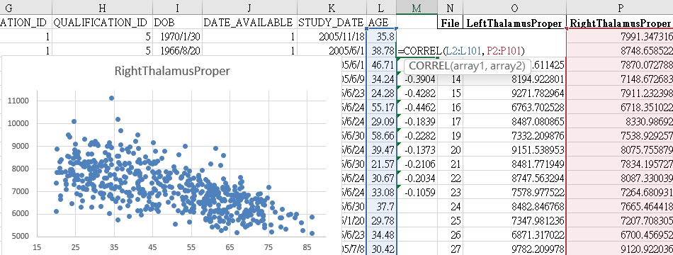
(3) Based on the demographic information provided by the original website, try to explore the correlation between the volumes of various subcortical regions and the subjects' information. For example, is there a correlation between the hippocampus or thalamus and the age of the subjects?

Slide 13
(3) Based on the demographic information provided by the original website, try to explore the correlation between the volumes of various subcortical regions and the subjects' information. For example, is there a correlation between the hippocampus or thalamus and the age of the subjects?

Slide 14
(3) Based on the demographic information provided by the original website, try to explore the correlation between the volumes of various subcortical regions and the subjects' information. For example, is there a correlation between the hippocampus or thalamus and the age of the subjects?

Slide 15
(3) Based on the demographic information provided by the original website, try to explore the correlation between the volumes of various subcortical regions and the subjects' information. For example, is there a correlation between the hippocampus or thalamus and the age of the subjects?
Correlation Coefficient(Ordered by Magnitude):Age and Gray Matter Volume

Slide 16
(3) Based on the demographic information provided by the original website, try to explore the correlation between the volumes of various subcortical regions and the subjects' information. For example, is there a correlation between the hippocampus or thalamus and the age of the subjects?
Correlation Coefficient(Ordered by Magnitude):Age and Gray Matter Volume

Slide 17
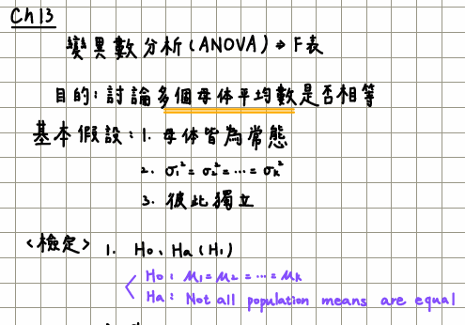
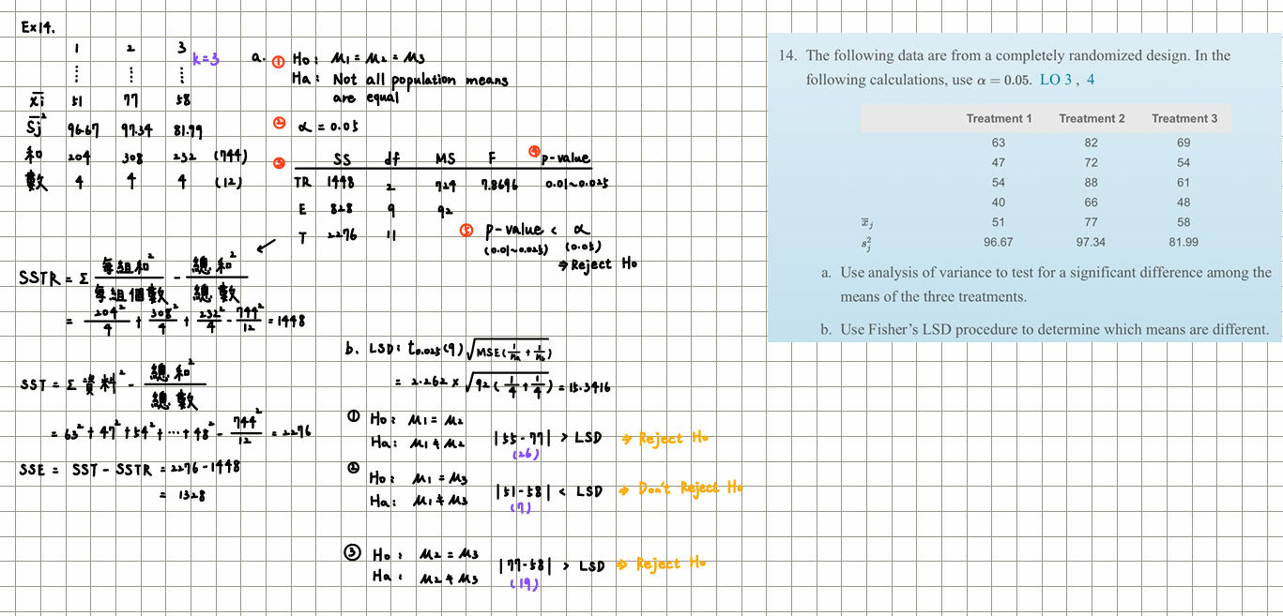
(3) Based on the demographic information provided by the original website, try to explore the correlation between the volumes of various subcortical regions and the subjects' information. For example, is there a correlation between the hippocampus or thalamus and the age of the subjects?
利用單因子變異數(ANOVA)計算p-value
Notes:
H0=沒有顯著差異」、「沒有關聯」或「變數之間的影響不存在」的假說
H0​ 是「原假設」，即假設所有組的均值相等。
可以拒絕h0=p值小=表示兩個以上資料之間關係可能是隨機性的機率很小數據間的差異不太可能是由隨機性引起的至少有兩組數據之間可能存在系統性差異或關係。
筆記中的步驟分析：計算了 F 值： 筆記完整地計算了 F 值 7.86967.8696。明確了自由度： dfTR=2df TR​ =2、dfE=9df E​ =9。查表： 根據 F 值和自由度，從 F 分布表中查得 p 值範圍 0.01<𝑝-value<0.0250.01<p-value<0.025。

Slide 18
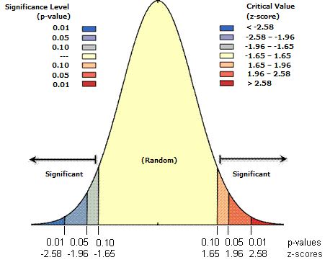
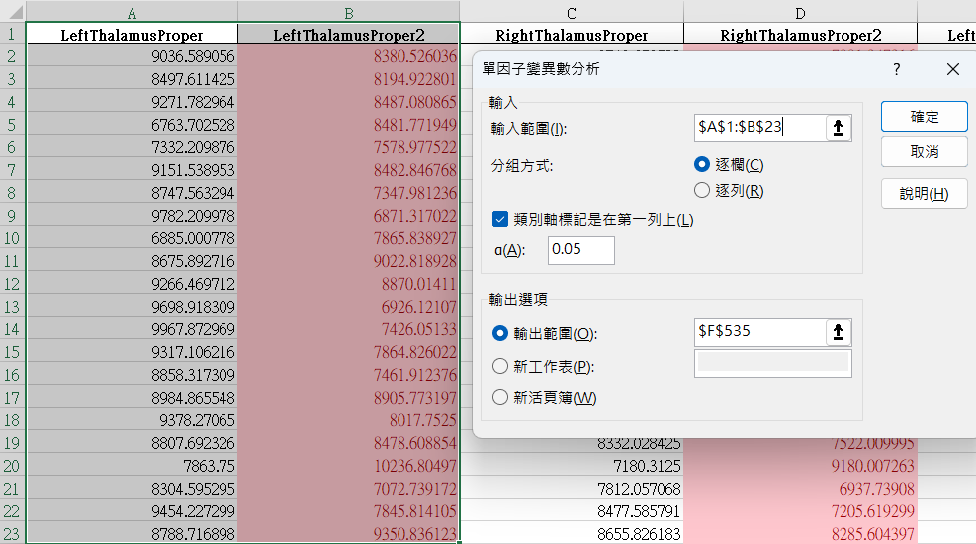
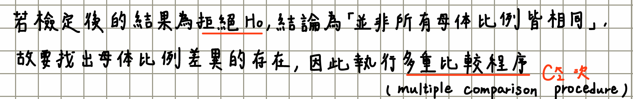
(3) Based on the demographic information provided by the original website, try to explore the correlation between the volumes of various subcortical regions and the subjects' information. For example, is there a correlation between the hippocampus or thalamus and the age of the subjects?
男女分兩行，利用單因子變異數(ANOVA)計算p-value

Slide 19
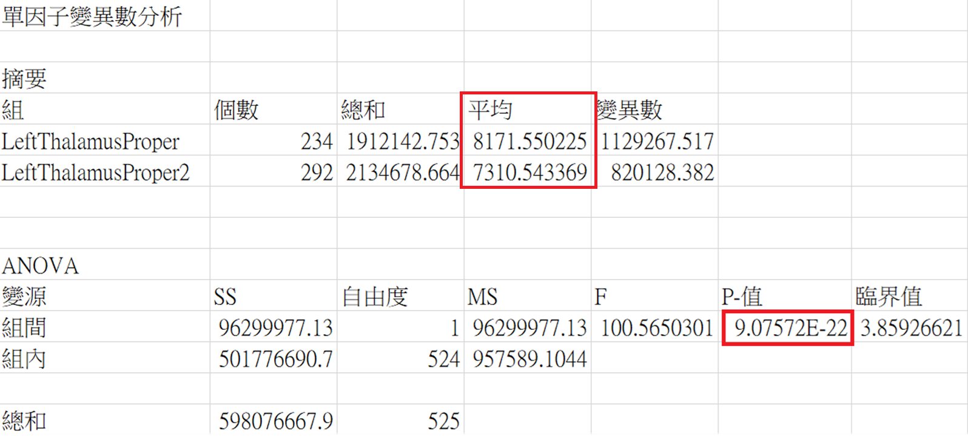
(3) Based on the demographic information provided by the original website, try to explore the correlation between the volumes of various subcortical regions and the subjects' information. For example, is there a correlation between the hippocampus or thalamus and the age of the subjects?
男女分兩行，利用單因子變異數(ANOVA)計算p-value

Slide 20
(3) Based on the demographic information provided by the original website, try to explore the correlation between the volumes of various subcortical regions and the subjects' information. For example, is there a correlation between the hippocampus or thalamus and the age of the subjects?
男女分兩行 已排除年齡關係；因男女年齡平均差不多 可確定體積也和男女相關

Slide 21
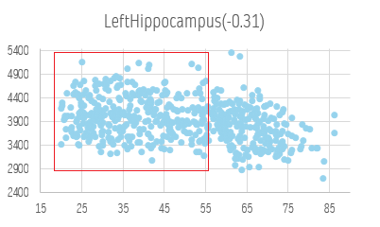
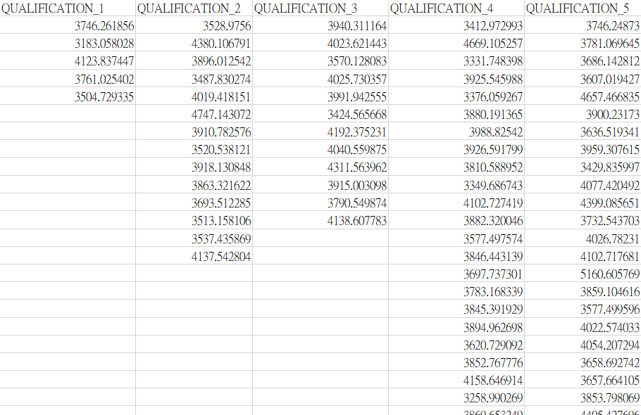
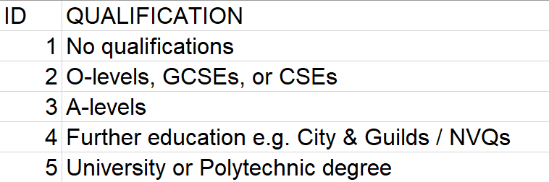
(3) Based on the demographic information provided by the original website, try to explore the correlation between the volumes of various subcortical regions and the subjects' information. For example, is there a correlation between the hippocampus or thalamus and the age of the subjects?
20~55歲，女性，LeftHippocampus體積關係

Slide 22
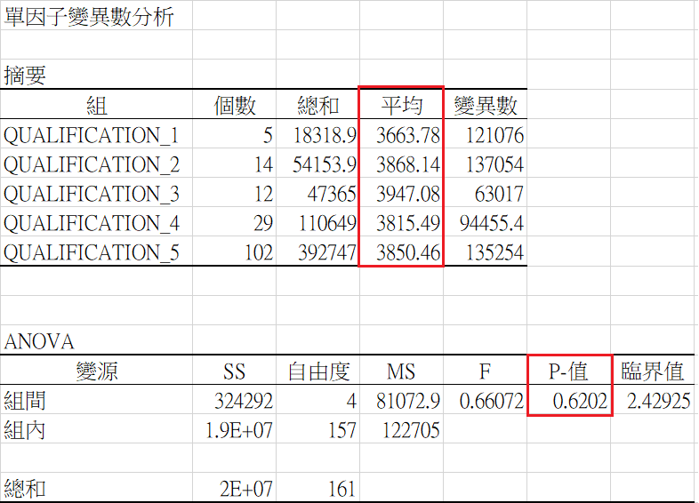
(3) Based on the demographic information provided by the original website, try to explore the correlation between the volumes of various subcortical regions and the subjects' information. For example, is there a correlation between the hippocampus or thalamus and the age of the subjects?
20~55歲，女性，LeftHippocampus體積關係

Slide 23
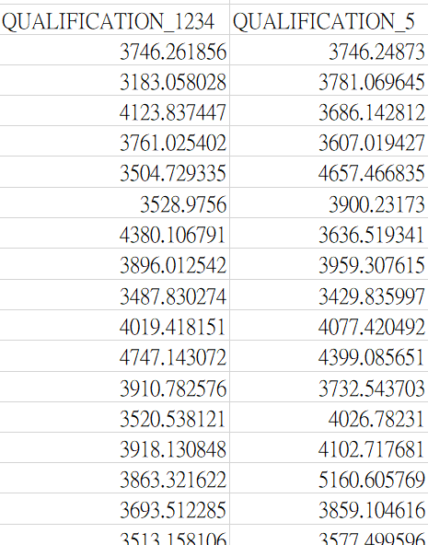
(3) Based on the demographic information provided by the original website, try to explore the correlation between the volumes of various subcortical regions and the subjects' information. For example, is there a correlation between the hippocampus or thalamus and the age of the subjects?
20~55歲，女性，LeftHippocampus體積關係

Slide 24
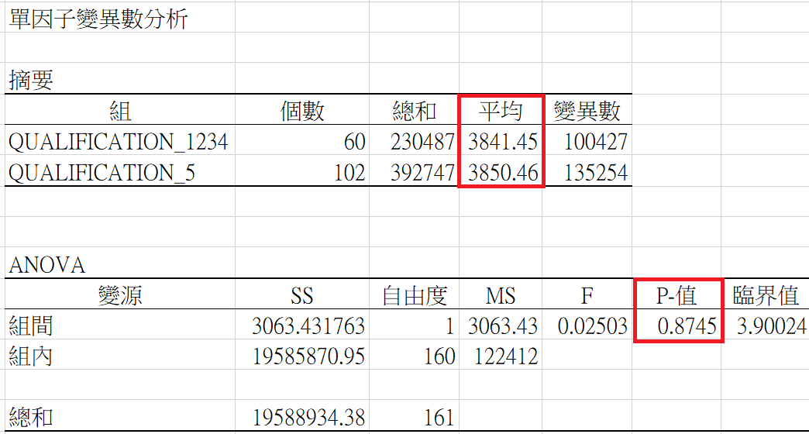
(3) Based on the demographic information provided by the original website, try to explore the correlation between the volumes of various subcortical regions and the subjects' information. For example, is there a correlation between the hippocampus or thalamus and the age of the subjects?
20~55歲，女性，LeftHippocampus體積關係

Slide 25
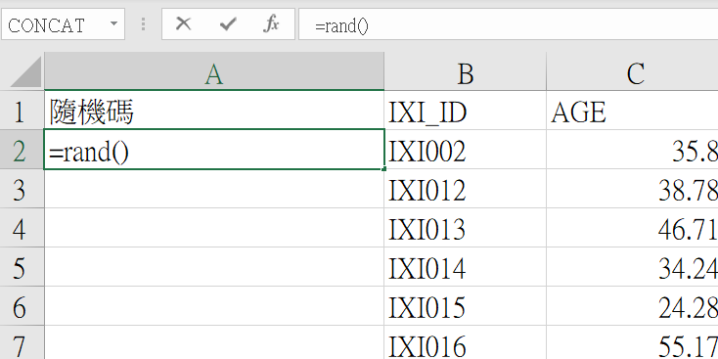
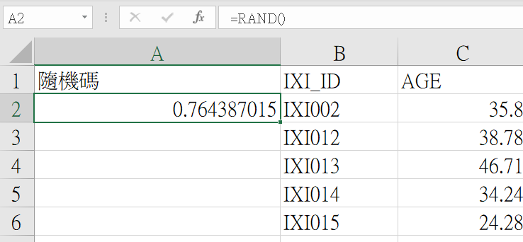
(6) (Optional) Use the encode function of TigerBx to generate the latent space from the T1-weighted image, and utilize the latent space to predict the age of the subjects.

Slide 26
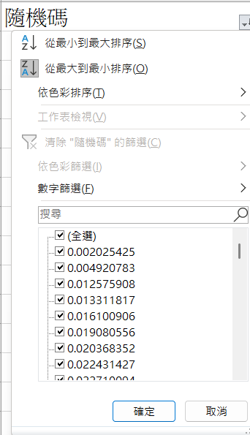
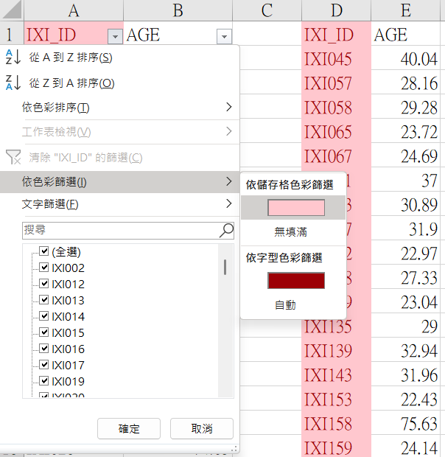
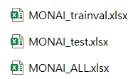
(6) (Optional) Use the encode function of TigerBx to generate the latent space from the T1-weighted image, and utilize the latent space to predict the age of the subjects.
Total=560
Test=560*15%=84 Train+Val=476

Slide 27
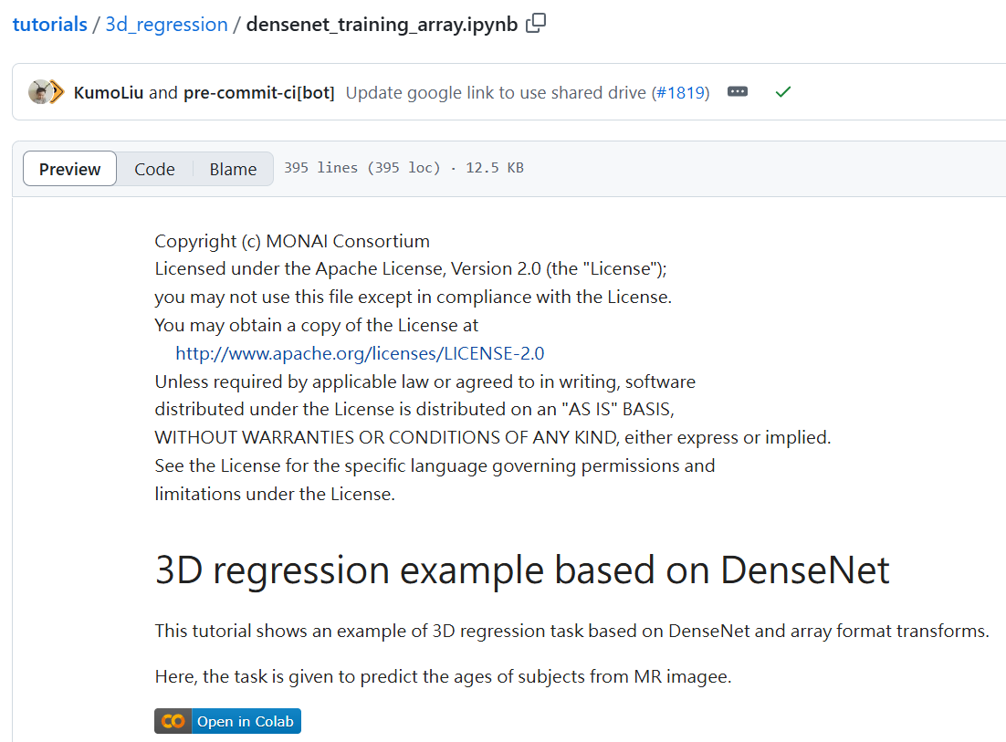
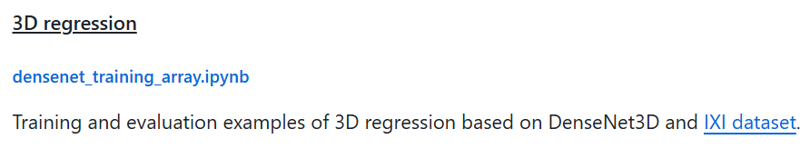
(6) (Optional) Use the encode function of TigerBx to generate the latent space from the T1-weighted image, and utilize the latent space to predict the age of the subjects.
https://github.com/Project-MONAI/tutorials/tree/main/3d_regression

Slide 28
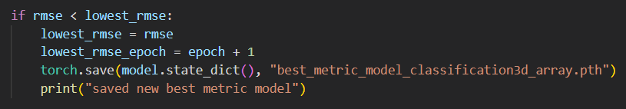
(6) (Optional) Use the encode function of TigerBx to generate the latent space from the T1-weighted image, and utilize the latent space to predict the age of the subjects.
https://github.com/Project-MONAI/tutorials/tree/main/3d_regression

Slide 29
(6) (Optional) Use the encode function of TigerBx to generate the latent space from the T1-weighted image, and utilize the latent space to predict the age of the subjects.
1.用原始nii.gz訓練+100epoch，train=70%、val=15%、test=15%
in_shape=[1, 96, 96, 96]
Notes:
1=t1影像通道 96*96*96 3d影像解析度

Slide 30
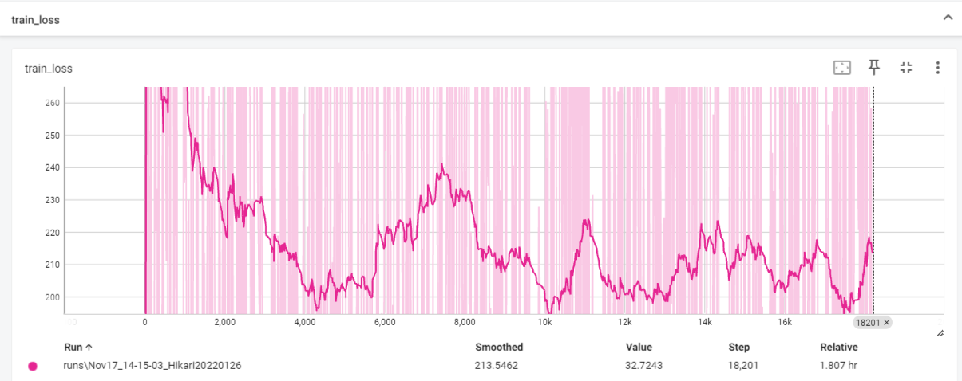
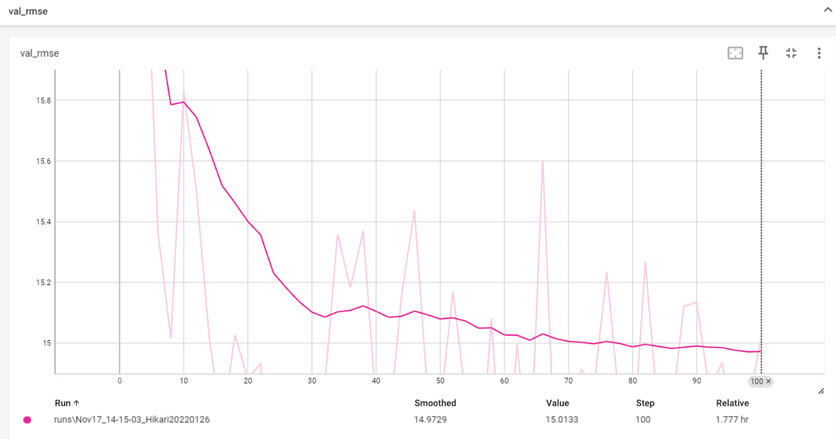
(6) (Optional) Use the encode function of TigerBx to generate the latent space from the T1-weighted image, and utilize the latent space to predict the age of the subjects.
用原始nii.gz訓練+100epoch，train=70%、val=15%、test=15%
Train_loss：
Val_rmse：

Slide 31
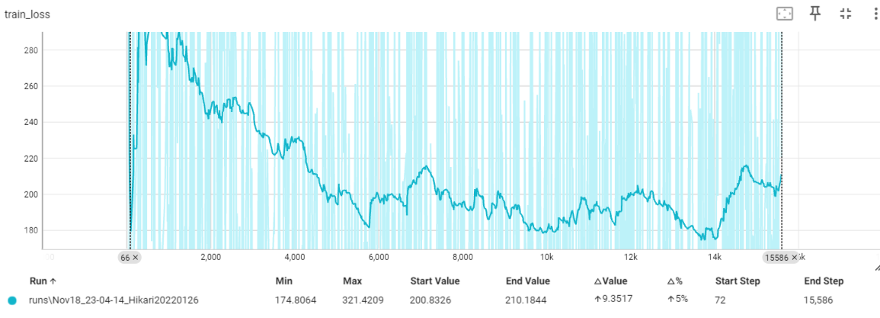
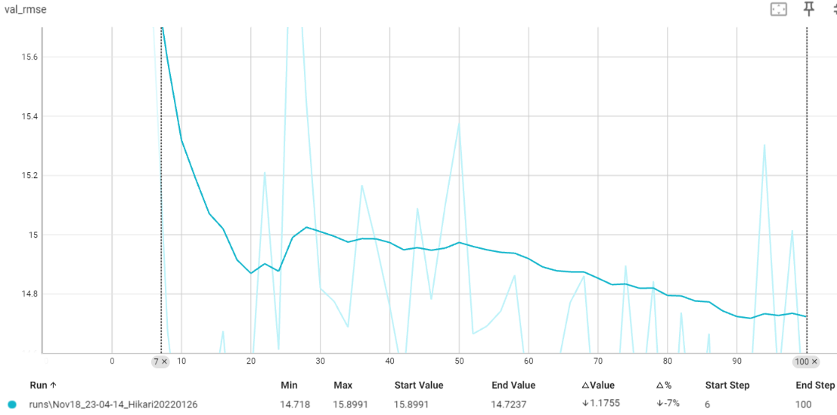
(6) (Optional) Use the encode function of TigerBx to generate the latent space from the T1-weighted image, and utilize the latent space to predict the age of the subjects.
用原始nii.gz訓練+100epoch，train=60%、val=25%、test=15%
Train_loss：
Val_rmse：

Slide 32
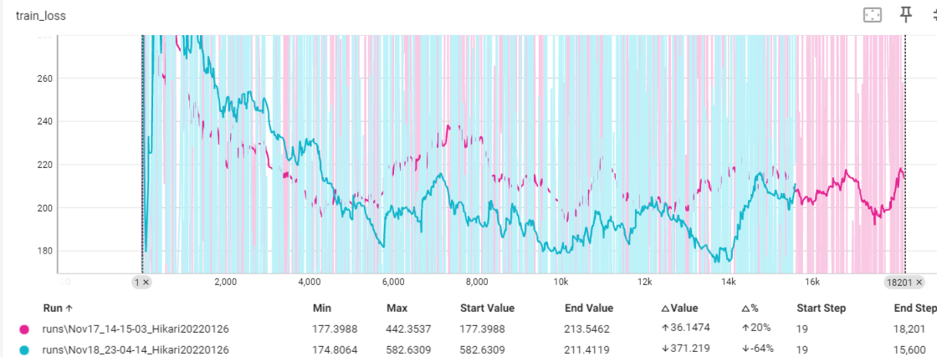
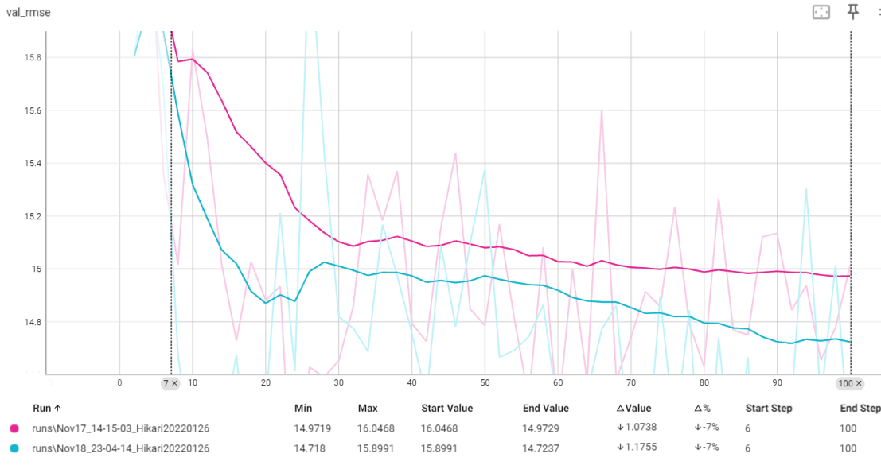
(6) (Optional) Use the encode function of TigerBx to generate the latent space from the T1-weighted image, and utilize the latent space to predict the age of the subjects.
5.用原始nii.gz訓練+100epoch，train=60% vs train=70%
Train_loss：
Val_rmse：
原始nii.gz train=70% Mse Train_loss min：177.3988
原始nii.gz train=60% Mse Train_loss min：174.8064
原始nii.gz train=70% Val_rmse min：14.9719
原始nii.gz train=60% Val_rmse min：14.718

Slide 33
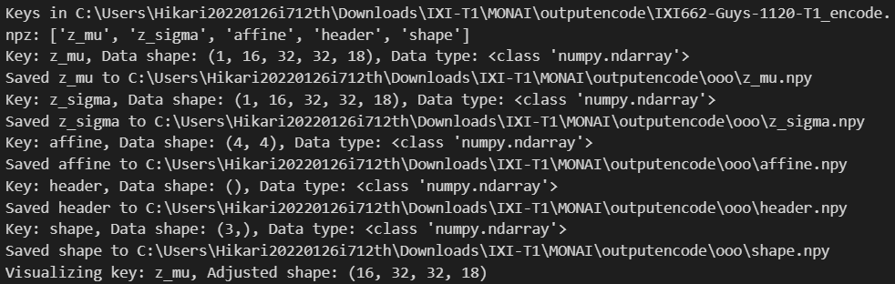
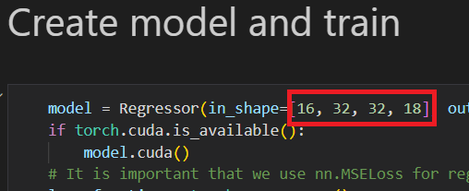
(6) (Optional) Use the encode function of TigerBx to generate the latent space from the T1-weighted image, and utilize the latent space to predict the age of the subjects.
2.用latent space(.npz) +100epoch ，train=70%、val=15%、test=15%
tigerbx.run('encode', r'C:\T1w_dir', r'C:\output_dir') # Create latent representation of the T1w image
Z_mu=in_shape=[16, 32, 32, 18]
Notes:
1=T1 加權 MRI 16=latent space維度 32*32*18 3d影像解析度

Slide 34
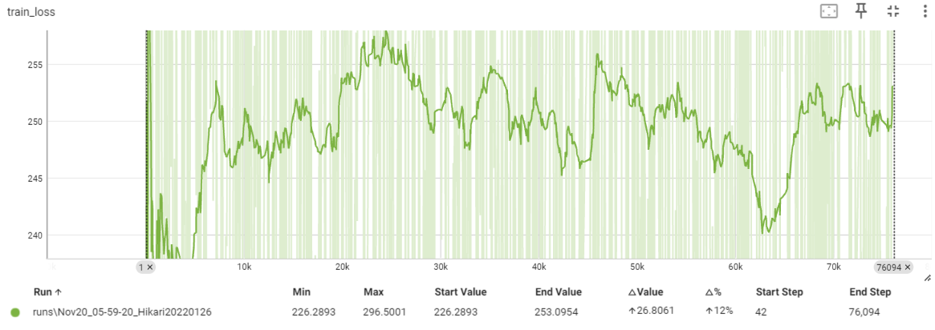
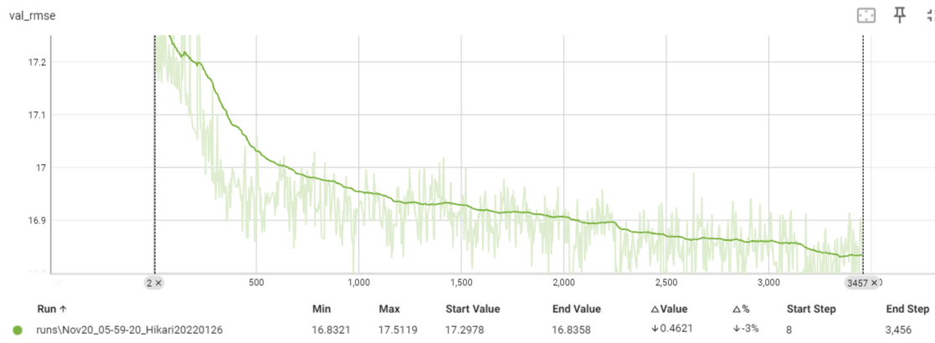
(6) (Optional) Use the encode function of TigerBx to generate the latent space from the T1-weighted image, and utilize the latent space to predict the age of the subjects.
2.用latent space(.npz) +3457epoch ，train=60%、val=15%、test=15%
Train_loss：
Val_rmse：
latent space train=60% Mse Train_loss min：226.2893
latent space train=60% Val_rmse min：16.8358

Slide 35
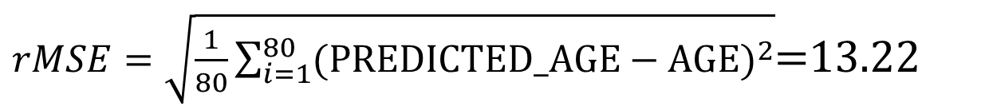
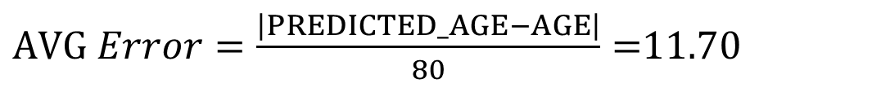
(6) (Optional) Use the encode function of TigerBx to generate the latent space from the T1-weighted image, and utilize the latent space to predict the age of the subjects.
用原始nii.gz訓練+100epoch，train=70%的權重檔ori70p.pth測試15%test測試集(80人)
$AVG Error=\frac{\left|PREDICTED_AGE−AGE\right|}{80}=$11.70
$rMSE=\sqrt{\frac{1}{80}\sum_{i=1}^{80}{{(PREDICTED_AGE−AGE)}^{2}}}$=13.22

Slide 36
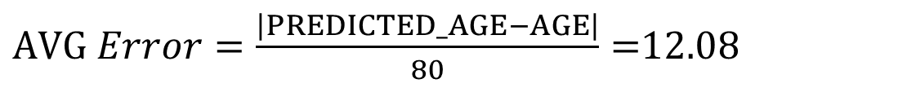
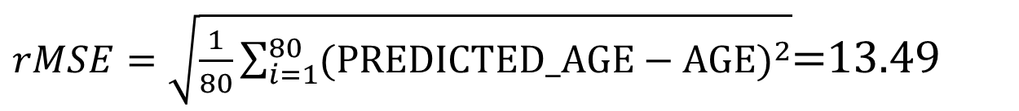
(6) (Optional) Use the encode function of TigerBx to generate the latent space from the T1-weighted image, and utilize the latent space to predict the age of the subjects.
用原始nii.gz訓練+100epoch，train=60%的權重檔ori60p.pth測試15%test測試集(80人)
$AVG Error=\frac{\left|PREDICTED_AGE−AGE\right|}{80}=$12.08
$rMSE=\sqrt{\frac{1}{80}\sum_{i=1}^{80}{{(PREDICTED_AGE−AGE)}^{2}}}$=13.49

Slide 37
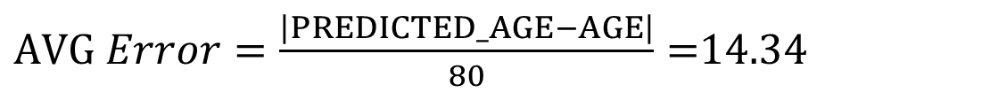
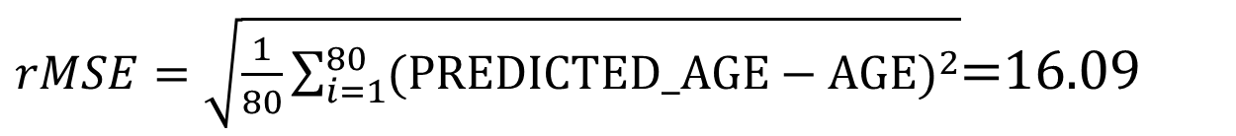
(6) (Optional) Use the encode function of TigerBx to generate the latent space from the T1-weighted image, and utilize the latent space to predict the age of the subjects.
用latent space(npz)訓練+3457epoch，train=60%的權重檔npz60p.pth測試15%test測試集(80人)
$AVG Error=\frac{\left|PREDICTED_AGE−AGE\right|}{80}=$14.34
$rMSE=\sqrt{\frac{1}{80}\sum_{i=1}^{80}{{(PREDICTED_AGE−AGE)}^{2}}}$=16.09

Slide 38

Thanks

